Slide 1
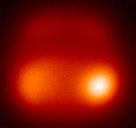
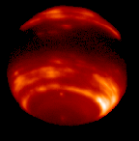
Adaptive Optics and its Applications
Lecture 1
Neptune with and without AO
Claire Max
UC Santa Cruz
January 9, 2020

Slide 2
Outline of lecture
Introductions, goals of this course
How the course will work
Overview of adaptive optics and its applications
Please remind me to stop for a break at 10:35 am !

Slide 3
Zoom techniques
Please identify yourself when you speak
  “This is Mary Smith from Santa Cruz”
Report technical problems to Graseilah Coolidge at 831-459-2991. If that doesn’t work, please text me at 510-717-1930 (my cell)
Microphones are quite sensitive, even on laptops
  Do not to rustle papers in front of them
  Mute your microphone if you are making side-comments, sneezes, eating lunch, whatever
  In fact, it’s probably best if you keep microphone muted until you want to ask a question or make a comment

Slide 4
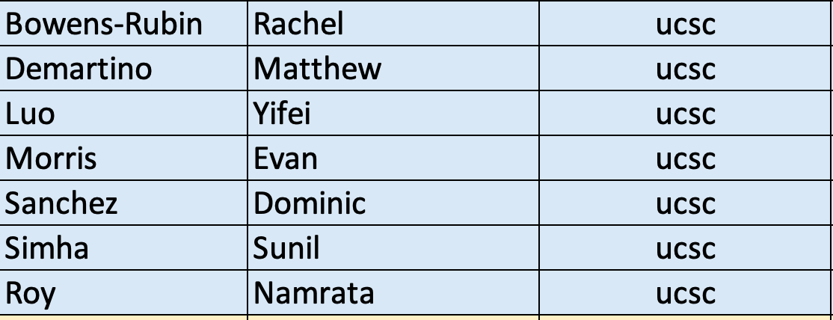
Who are we? continued
In the CfAO conference room at UCSC:

Slide 5
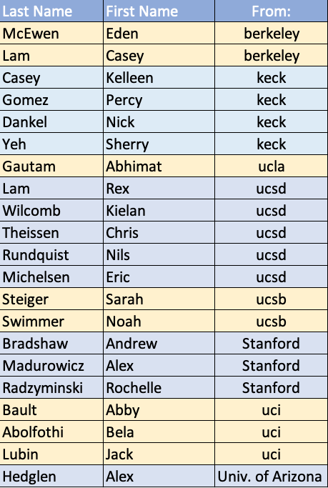
Introductions: who are we?
Via Zoom:
If I haven’t listed you on this slide or the previous one, please say who you are (and send me an email)
Notes:
Claire: introduce yourself as well

Slide 6
Goals of this course
To understand the main concepts and components behind adaptive optics systems
To understand how to do astronomical observations with AO (what is AO good for, what is it not good for?)
To get acquainted with AO components in the Lab
Brief introduction to non-astronomical applications
I hope to interest a few of you in learning more AO, and doing research in the field

Slide 7
Course websites
Main: http://www.ucolick.org/~max/289
  Lectures will be on web before each class
  Homework assignments (and, later, solutions)
  Reading assignments
Auxiliary: Canvas at UCSC
  https://canvas.ucsc.edu/courses/29723
  Will be used for some of the reading material
    UCSC students: use your Gold login
    Others: I’ll email readings to you; they will be password protected

Slide 8
Required Textbook
Field Guide to Astronomical Instrumentation by Keller, Navarro, and Brandl
  Available from SPIE
  I found this small spiral book very useful for lots of things
Readings from the academic literature available from Canvas or via email from me, password protected

Slide 9
Outline of lecture
Introductions, goals of this course
How the course will work
Overview of adaptive optics

Slide 10
Course components
Lectures
Reading assignments
Homework problems
Project
Laboratory exercises
Final exam (take-home)
Notes:
Ask who has been to Lick Observatory or to any other observatory

Slide 11
How People Learn
Research shows that the traditional passive lecture is far from the most effective teaching tool.
It is not possible for an instructor to pour knowledge into the minds of students.
It is the students who must actively engage in the subject matter in a manner that is meaningful to them.
Hence this course will use several departures from the traditional lecture format, to encourage active learning and understanding of concepts.

Slide 12
I will post lectures prior to each class; you can download them
http://www.ucolick.org/~max/289/
I strongly suggest that those of you who are attending via video download the lectures prior to class, and project them locally
I’ll also project them via Zoom

Slide 13
Concept Questions
Lectures will discuss the underlying concepts and key points, elaborate on reading, and address difficulties.
  I will assume you have already done a first pass through the reading
As feedback to me, lectures will include Concept Questions
You will be asked to first formulate your own answer, then to discuss your answer with each other, and finally to report each group’s answers to the class as a whole.

Slide 14
Reading Assignments
I will expect you to do the reading BEFORE class
Then if you want, go back and read more deeply after the lecture, to resolve areas which seem confusing
From time to time I will give quick “Reading Quizzes” at the start of a class, where I ask few questions that you’ll be able to answer easily if you’ve spent even 20 minutes looking at the reading assignment

Slide 15
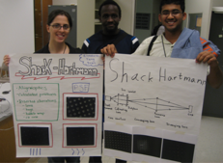
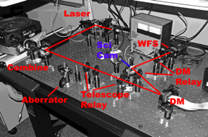
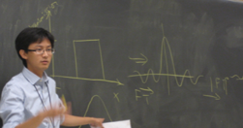
Inquiry Labs: Designed by grad students in the ISEE Professional Development Program
AO Demonstrator
Learning goals:
  3 main components of AO system
  Ray-trace diagram
  Optical conjugation
  Focus and magnification
  Alignment techniques
  Performance of AO system
Fourier Optics
Learning goals:
  Pupil plane and focal plane
  Relationship between aperture and PSF
  Phase errors and effects, including speckles
  Wavefront error and Shack-Hartmann spots
Would be great if out-of-town students could travel to UCSC for these,
but not required unless you are enrolled

Slide 16
Class Project: Design an AO system to meet your chosen scientific goals
Group activity
Learning goals:
  Systems thinking
  Requirements-driven design
  Optimization and tradeoffs
  Wavefront error terms and error budget
Activity outline:
  Choose a science goal
  Sketch out the design of an AO system that best meets your science goal
  Justify design decisions with an error budget
  Present your design to the class

Slide 17
A “textbook in the process of being written”
I’ve been asked to write an AO textbook by Princeton University Press
I’ll be asking for your help with homework problems
  For problems that I assign to you, tell me what works, what doesn’t
  From time to time, I’ll ask YOU to develop a homework problem, and then answer it
  Sometimes I’ll ask you to trade problems, so each person does a problem that someone else came up with

Slide 18
Homework for Tuesday Jan 14th (see website for details)
Read Syllabus carefully (download from class website)
Do Homework # 1: “Tell me about yourself”
  Specific questions on web, won’t take long
  Email your responses to me from your favorite email address, so I’ll know how to reach you
  Always make the subject line “289” so I won’t lose your email
Reading assignment: Imaging through turbulence
  Intro to imaging through turbulence by myself
  More rigorous derivation by Quirrenbach
  See class website for details and to download (public domain)

Slide 19
Outline of lecture
Introductions, goals of this course
How the course will work
Overview of adaptive optics

Slide 20
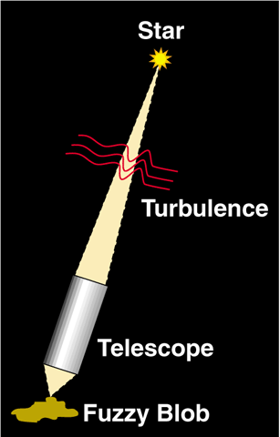
Why is adaptive optics needed?
Turbulence in earth’s atmosphere makes stars twinkle
More importantly, turbulence spreads out light; makes it a blob rather than a point
Even the largest ground-based astronomical
telescopes have no better resolution than an 8" telescope!

Slide 21
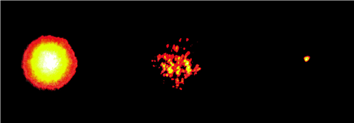
Images of a bright star, Arcturus
Lick Observatory, 1 m telescope
θ ~ 1 arc sec
θ ~ λ / D
Long exposure
image
Short exposure
image
Image with adaptive optics
Speckles (each is at diffraction limit of telescope)
Notes:
Ask what the meaning of lambda/D is

Slide 22
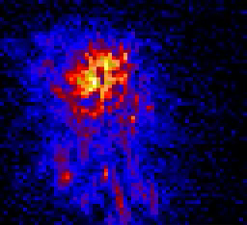
Turbulence changes rapidly with time
Image is spread out into speckles
Centroid jumps around
(image motion)
“Speckle images”: sequence of short snapshots of a star, taken at Lick Observatory using the IRCAL infra-red camera

Slide 23
Turbulence arises in many places
stratosphere
tropopause
10-12 km
wind flow over dome
boundary layer
~ 1 km
Heat sources w/in dome
Notes:
Ask class to suggest sources of turbulence

Slide 24
Atmospheric perturbations cause distorted wavefronts
Rays not parallel
Index of refraction
variations
Plane Wave
Distorted
Wavefront

Slide 25
Optical consequences of turbulence
Temperature fluctuations in small patches of air cause changes in index of refraction (like many little lenses)
Light rays are refracted many times (by small amounts)
When they reach telescope they are no longer parallel
Hence rays can’t be focused to a point:
Point focus
Blur
Parallel light rays
Light rays affected by turbulence

Slide 26
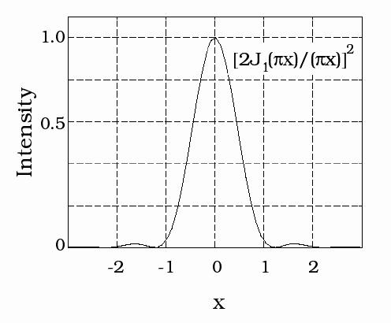
Imaging through a perfect telescope
With no turbulence, FWHM is diffraction limit of telescope, θ ~ λ / D
Example:
λ / D = 0.02 arc sec for λ = 1 μm, D = 10 m
With turbulence, image size gets much larger (typically 0.5 - 2 arc sec)
FWHM ~λ/D
1.22 λ/D
in units of λ/D
Point Spread Function (PSF): intensity profile from point source

Slide 27
Characterize turbulence strength by quantity r₀
Wavefront of light
r₀
“Fried’s parameter”
Primary mirror of telescope
“Coherence Length” r₀ : distance over which optical phase distortion has mean square value of 1 rad² (r₀ ~ 15 - 30 cm at good observing sites)
r₀ = 10 cm for seeing of 1 arc sec at λ = 0.5 μm

Slide 28
Effect of turbulence on image size
If telescope diameter D >> r₀ , image size of a point source is λ / r₀ >> λ / D
r₀ is diameter of the circular pupil for which the diffraction limited image and the seeing limited image have the same angular resolution.
Any telescope with diameter D > r₀ has no better spatial resolution than a telescope for which D = r₀ (!)
λ / D
“seeing disk”
λ / r₀

Slide 29
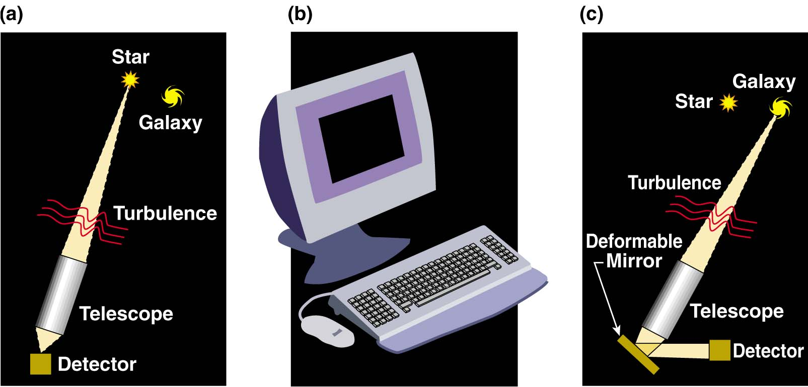
How does adaptive optics help?
(cartoon approximation)
Measure details of blurring from “guide star” near the object you want to observe
Calculate (on a computer) the shape to apply to deformable mirror to correct blurring
Light from both guide star and astronomical object is reflected from deformable mirror; distortions are removed

Slide 30
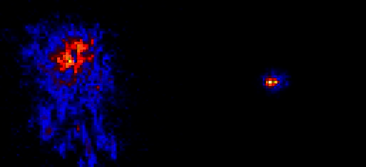
Infra-red images of a star, from Lick Observatory adaptive optics system
No adaptive optics
With adaptive optics
Note: “colors” (blue, red, yellow, white) indicate increasing intensity

Slide 31
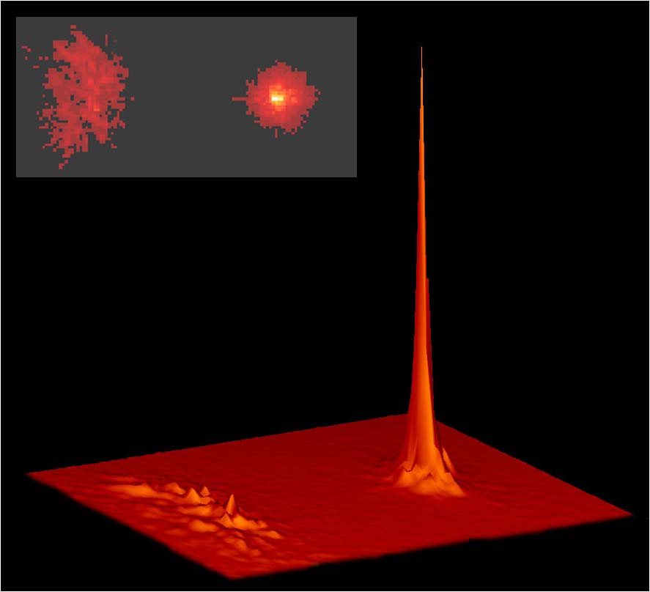
Adaptive optics increases peak intensity of a point source
Lick Observatory
No AO
With AO
Intensity
No AO
With AO

Slide 32
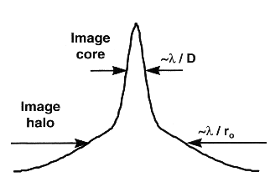
AO produces point spread functions with a “core” and “halo”
Definition of “Strehl”:
Ratio of peak intensity to that of “perfect” optical system
Intensity
x
When AO system performs well, more energy in core
When AO system is stressed (poor seeing), halo contains larger fraction of energy (diameter ~ r₀)
Ratio between core and halo varies during night

Slide 33
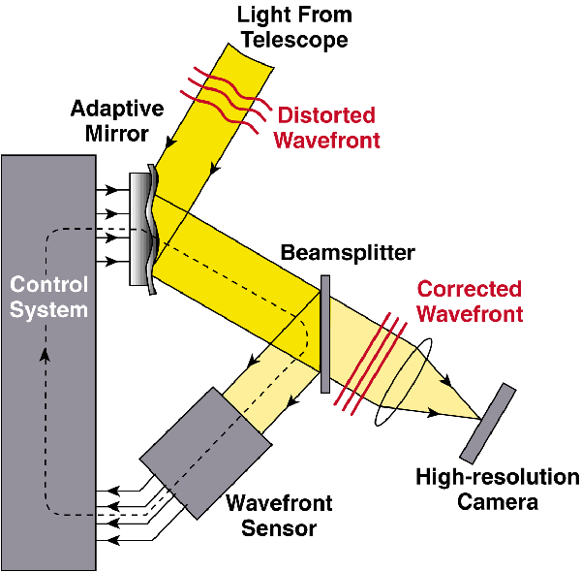
Schematic of adaptive optics system
Feedback loop: next cycle corrects the (small) errors of the last cycle

Slide 34
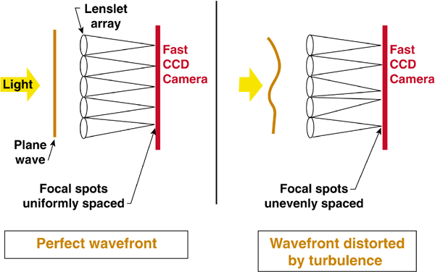
How to measure turbulent distortions (one method among many)
Shack-Hartmann wavefront sensor

Slide 35
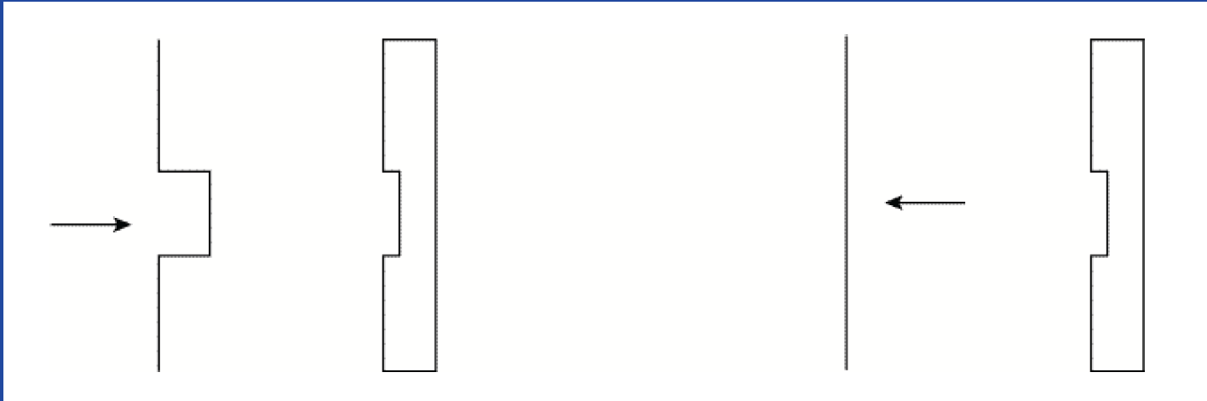
How a deformable mirror works (idealization)
BEFORE
AFTER
Incoming Wave with Aberration
Deformable Mirror
Corrected Wavefront

Slide 36
Deformable Mirror for Real Wavefronts

Slide 37
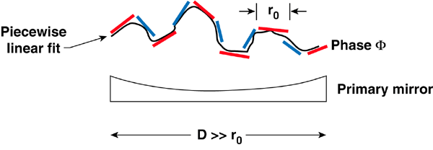
Real deformable mirrors have smooth surfaces
In practice, a smaller deformable mirror with a thin bendable face sheet is used
Frequently placed after main telescope mirror

Slide 38
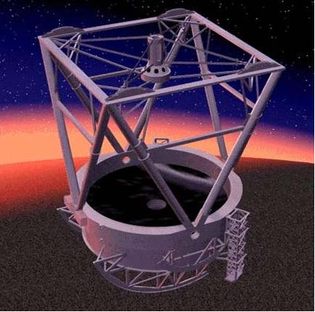
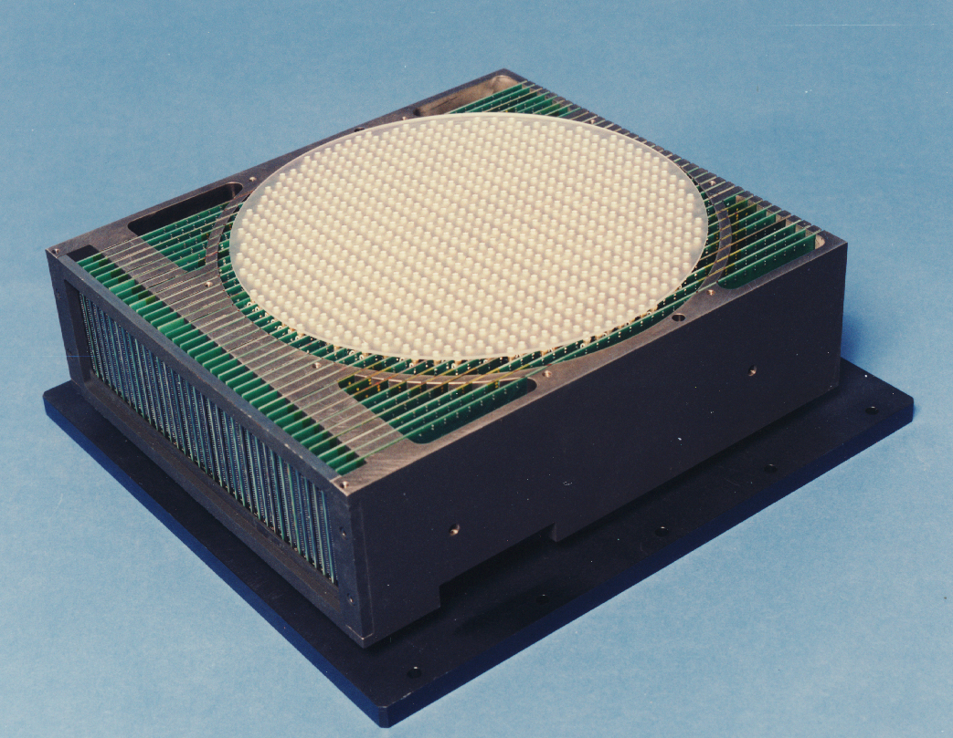
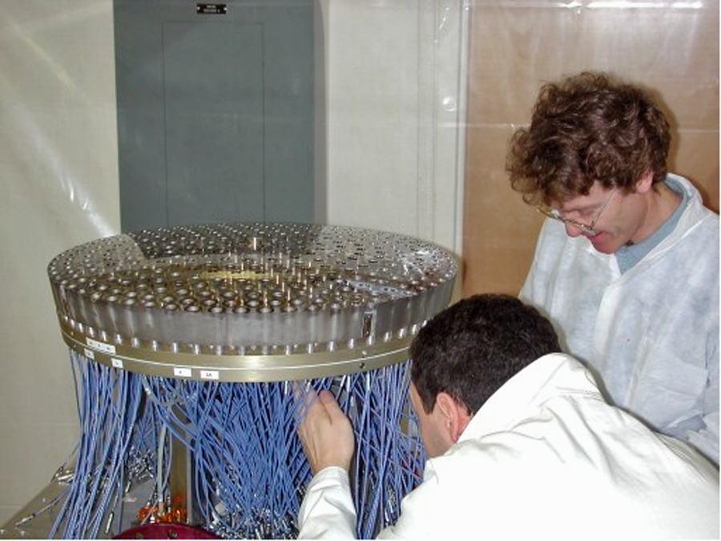
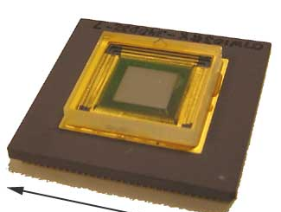
Deformable mirrors come in many sizes
Glass facesheet
1000 actuators
Adaptive Secondary Mirrors
30 cm
Xinetics
MEMS
1000 actuators
Boston
Micro-
Machines
1 cm
U Arizona

Slide 39
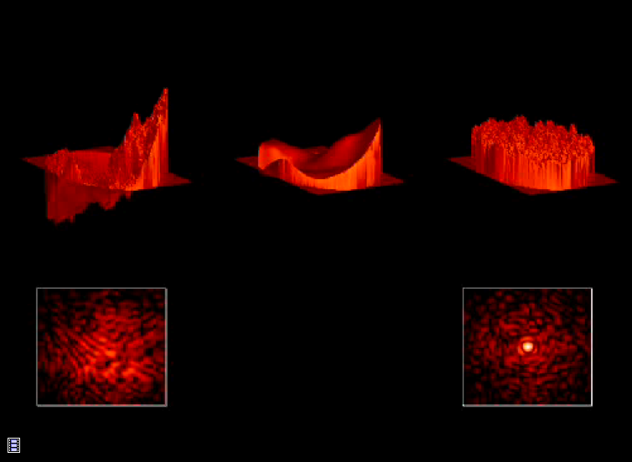
Incident wavefront
Shape of
Deformable Mirror
Corrected wavefront
Log (intensity)
Log (intensity)
Credit: J. Lloyd

Slide 40
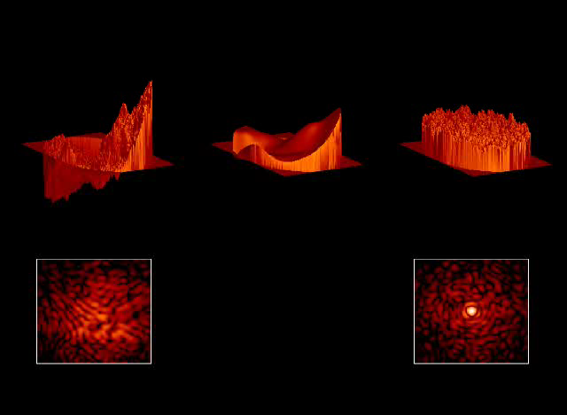

Slide 41
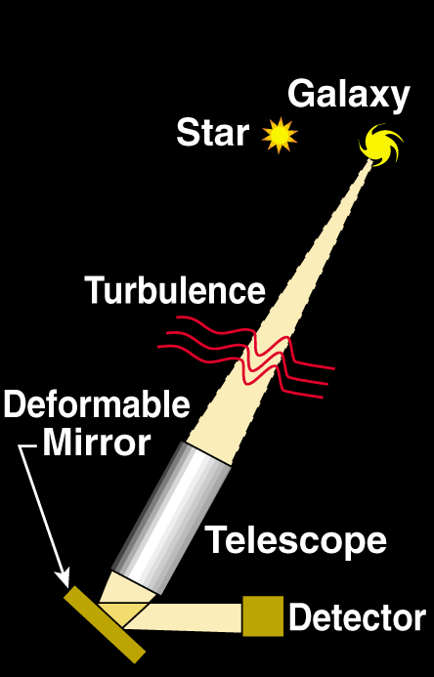
If there’s no close-by “real” star, create one with a laser
Use a laser beam to create artificial “star” at altitude of 100 km in atmosphere

Slide 42
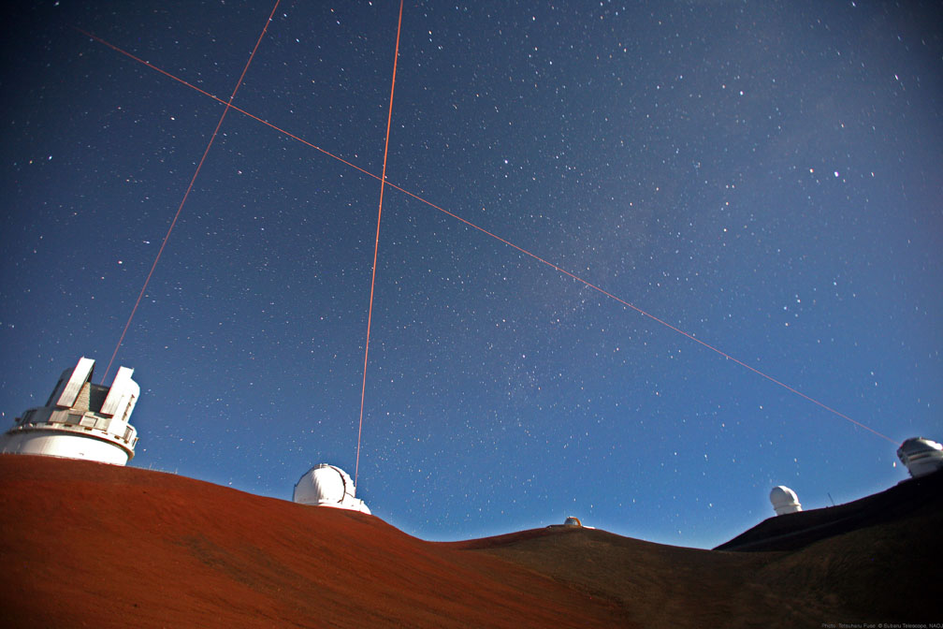
Laser guide stars are operating at Lick, Keck, Gemini N & S, VLT, Subaru, …
Four lasers on Mauna Kea: Keck 1 and 2, Gemini, Subaru telescopes

Slide 43
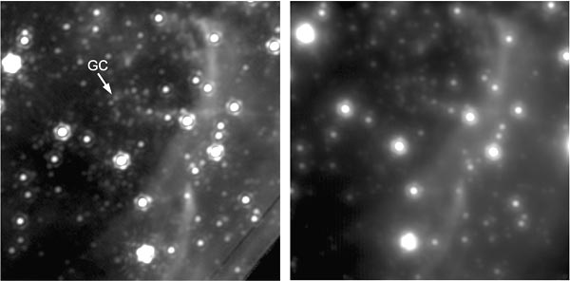
Galactic Center with Keck laser guide star
(GC is location of supermassive black hole)
Keck laser guide star AO
Best natural guide star AO
Source: UCLA Galactic Center group

Slide 44
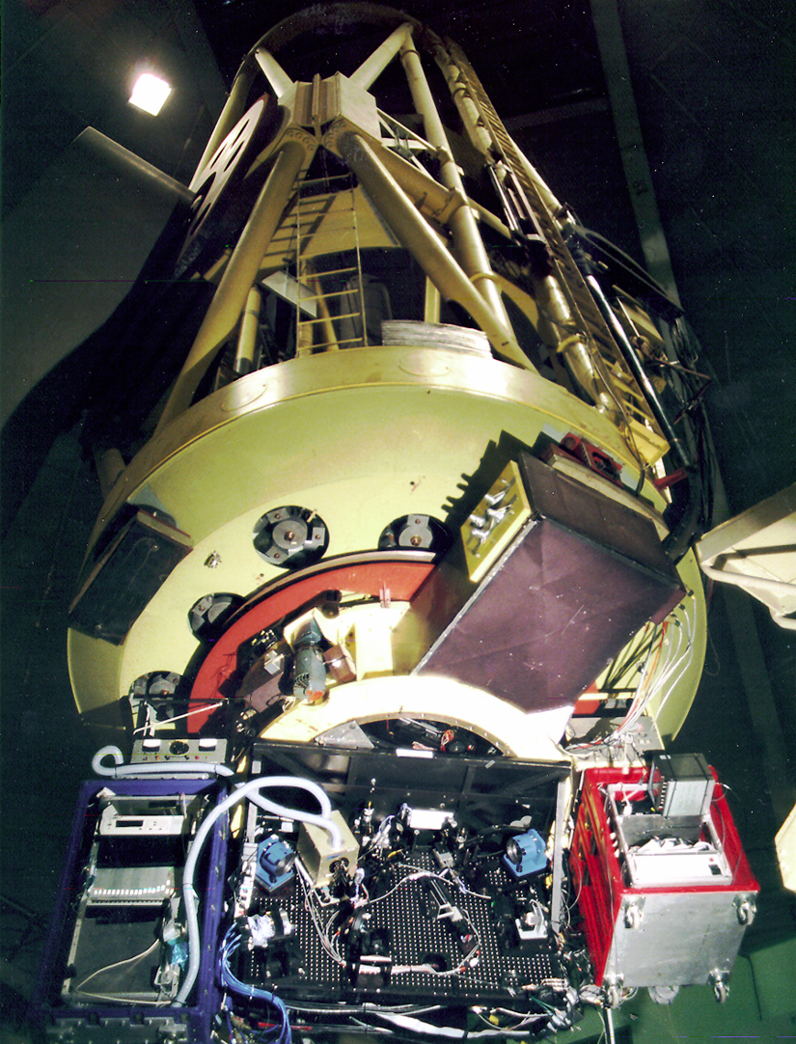
Adaptive optics system is frequently behind the main telescope mirror
Example: AO system at Lick Observatory’s 3 m telescope
Support for main
telescope mirror
Adaptive optics package below main mirror

Slide 45
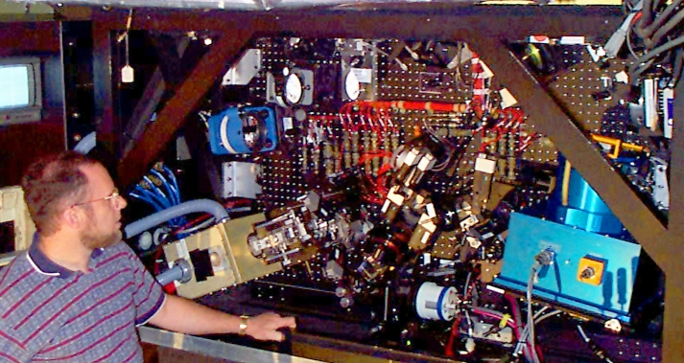
Original Lick adaptive optics system at 3m Shane Telescope
DM
Off-axis parabola mirror
IRCAL infra-red camera
Wavefront sensor

Slide 46
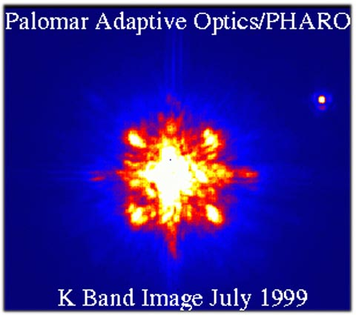
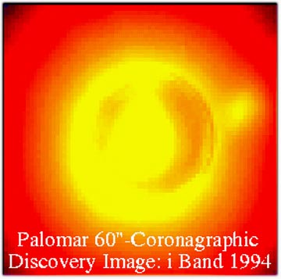
Adaptive optics makes it possible to find faint companions around bright stars
Two images from Palomar of a brown dwarf companion to GL 105
200” telescope
No AO
With AO
Credit: David Golimowski

Slide 47
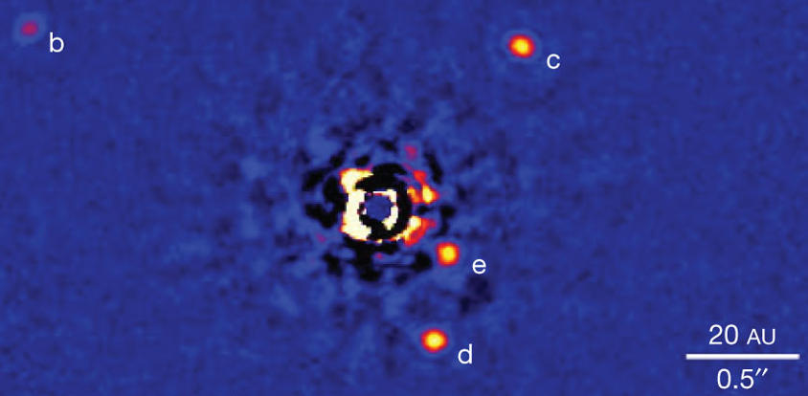
Four-planet system HR 8799
Marois et al. 2007

Slide 48
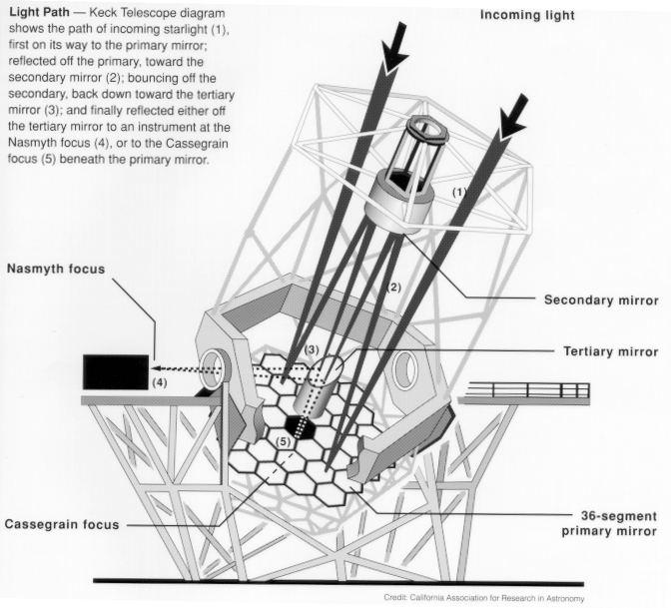
The Keck Telescopes
Adaptive optics
lives here

Slide 49
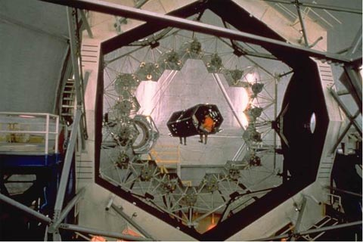
Keck Telescope’s primary mirror consists of 36 hexagonal segments
Nasmyth
platform
Person!

Slide 50
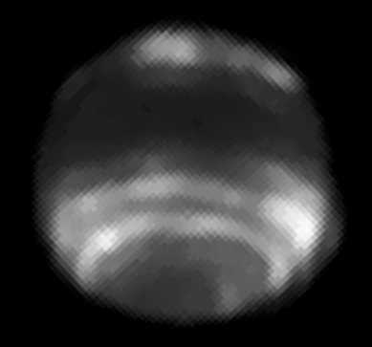
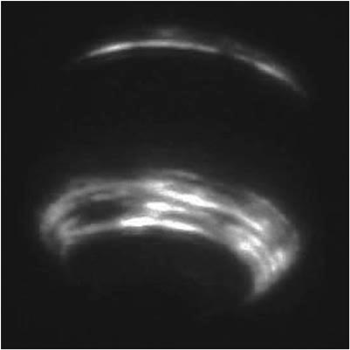
Neptune at 1.6 μm: Keck AO exceeds resolution of Hubble Space Telescope
HST – NICMOS Keck AO
~ 2 arc sec
2.4 meter telescope
10 meter telescope
(Two different dates and times)

Slide 51
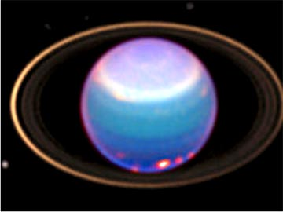
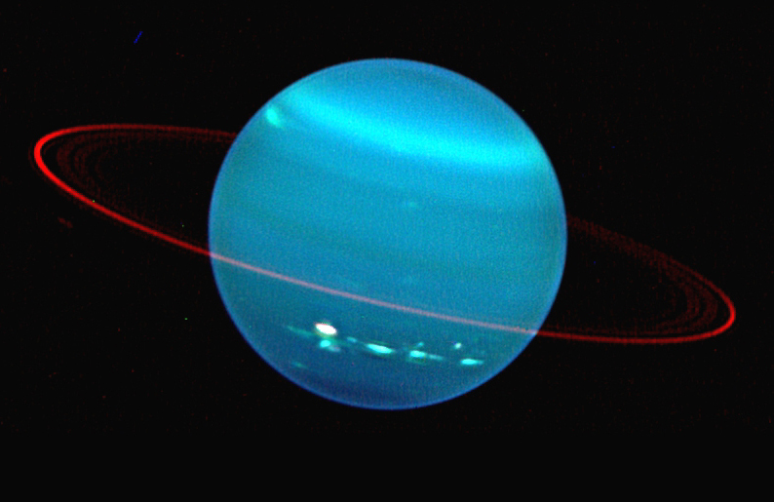
Uranus with Hubble Space Telescope and Keck AO
L. Sromovsky
HST, Visible
Keck AO, IR
Lesson: Keck in near IR has ~ same resolution as Hubble in visible

Slide 52
Some frontiers of astronomical adaptive optics
Current systems (natural and laser guide stars):
  How can we measure the Point Spread Function while we observe?
  How accurate can we make our photometry? astrometry?
Future systems:
  How far can we push new AO systems to achieve very high contrast ratios, to detect planets around nearby stars?
  How can we best achieve a wider AO field of view?
  How can we do AO for visible light (replace Hubble on the ground)?
  How can we do laser guide star AO on future 30-m telescopes?

Slide 53
Frontiers in AO technology
New kinds of deformable mirrors with > 5000 degrees of freedom
Wavefront sensors that can deal with this many degrees of freedom
Innovative control algorithms
“Tomographic wavefront reconstuction” using multiple laser guide stars
New approaches to doing visible-light AO

Slide 54
Other AO applications
Biology
  Imaging the living human retina
  Improving performance of microscopy (e.g. of cells)
Free-space laser communications (thru air)
Imaging and remote sensing (thru air)
Correcting beam quality of high power lasers

Slide 55
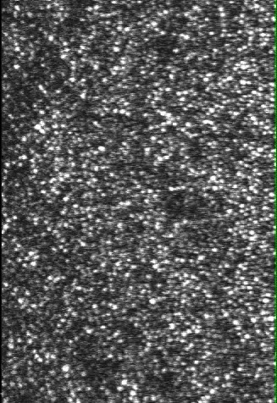
Sneak preview of AO retinal imaging
Individual cones – color receptors
Watch white blood cells flow through capillaries (!)

Slide 56
Enjoy!

